Slide 1
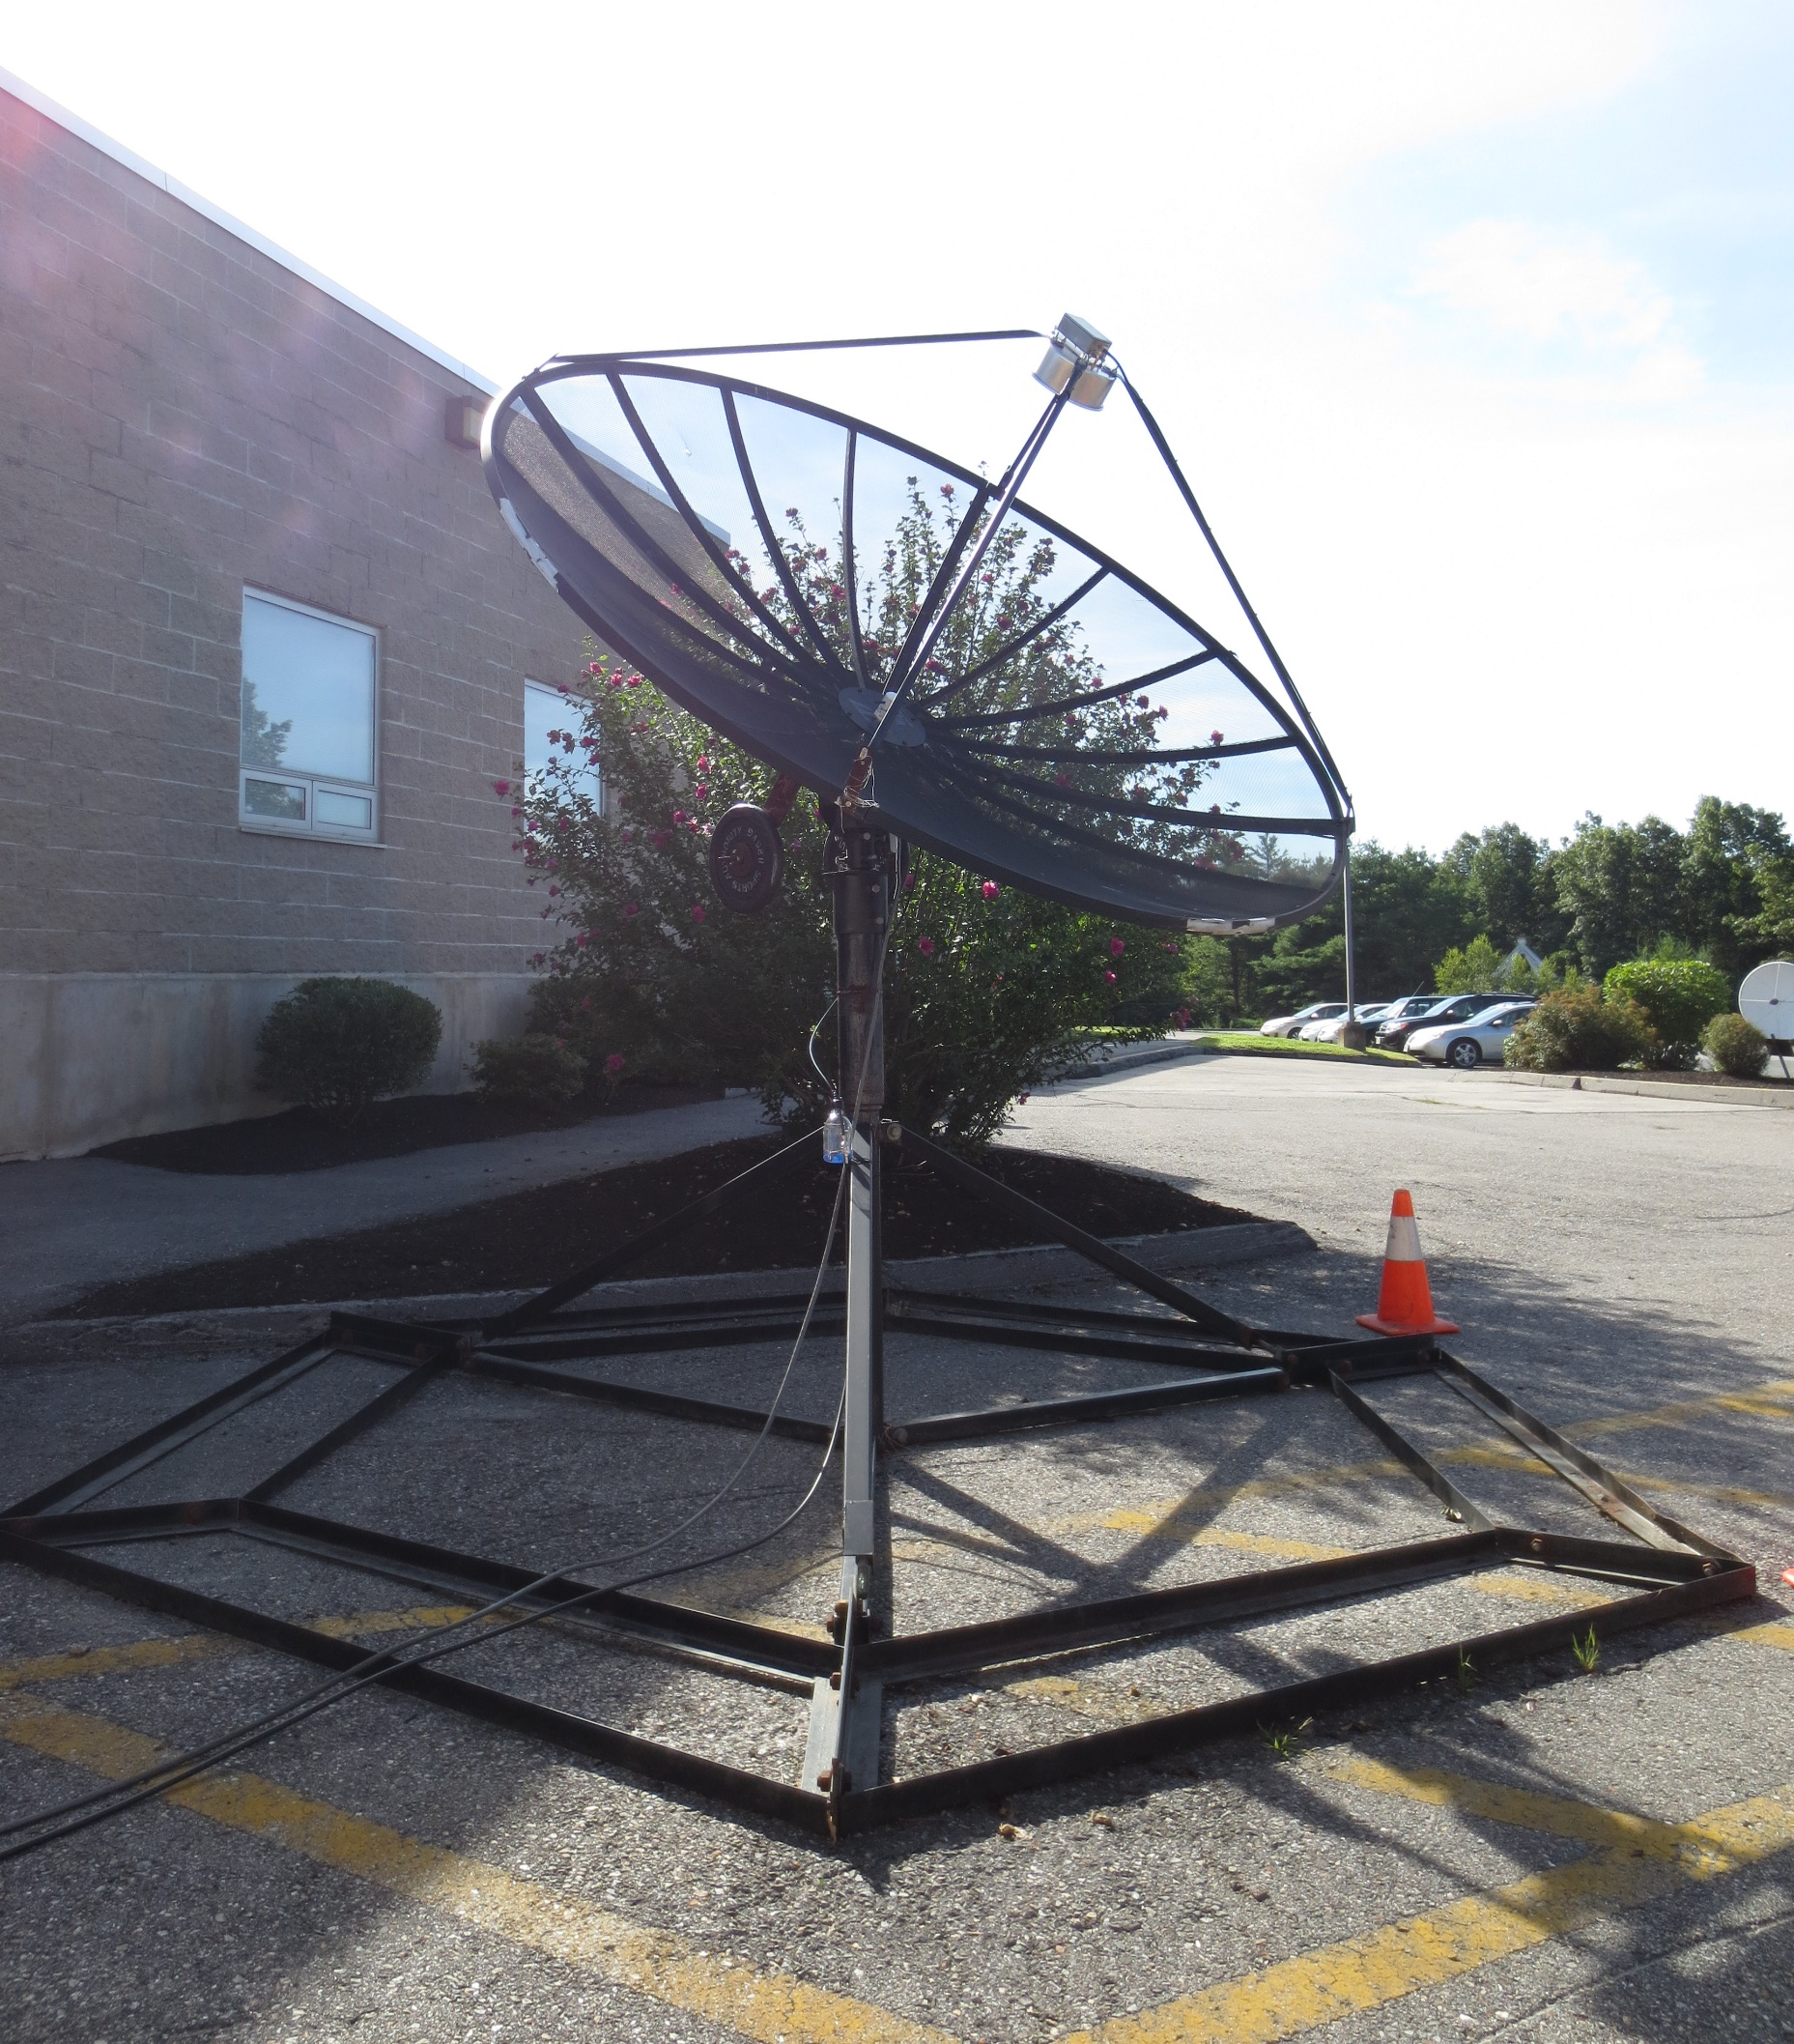

Small Radio Telescope (SRT) Refurbishment
Clayton Hanson

Slide 2
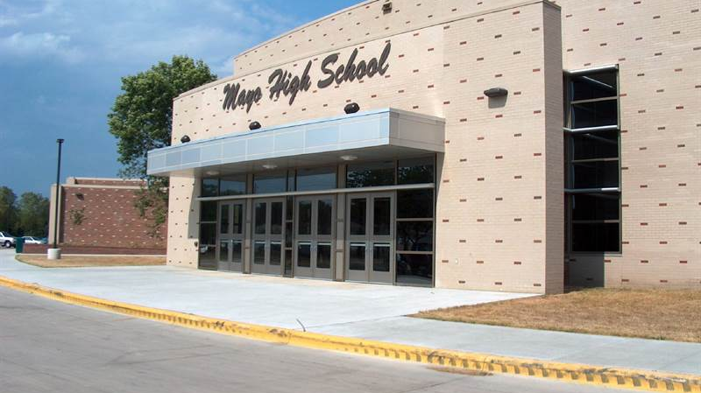
Special Thanks to Mayo High School!

Slide 3
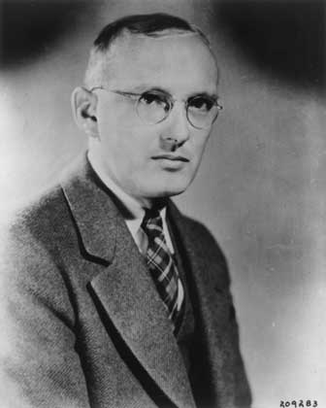
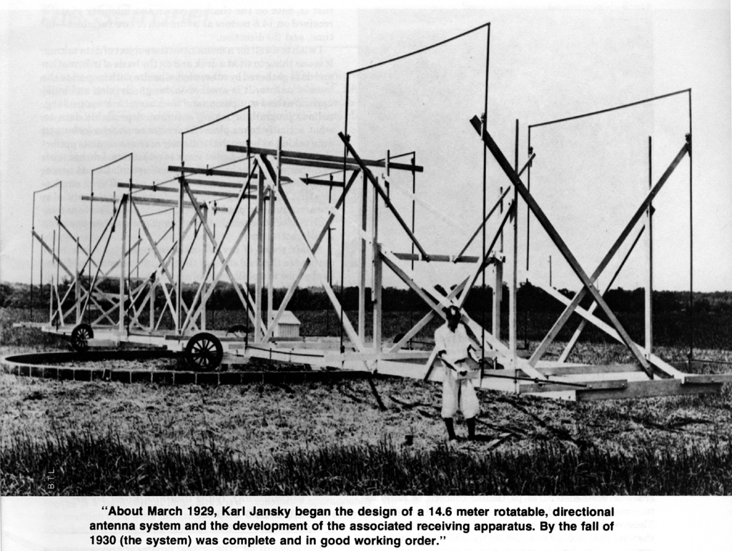
Karl Jansky – The First Radio Astronomer
Began working for Bell Labs in 1928
Designed and performed observations with the first radio telescope (bottom left).
Used entirely analog sensors and required all measurements be recorded by hand.
He found various sources of interference in his work, including weather related radio signals and what he termed “Star Noise”.

Slide 4
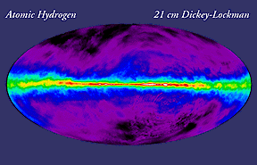
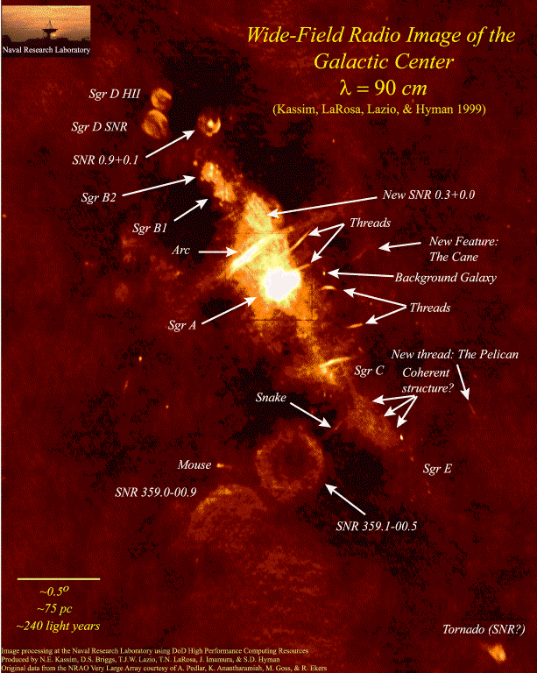
What is it? Why are we doing this?
There are several uses for a Radio Telescope
Observations of weather phenomena within our atmosphere
Observations of radio emissions from celestial objects such as moons, planets or the sun
General scans of the sky to see the radio wavelength emissions that the Earth receives (top).

Slide 5
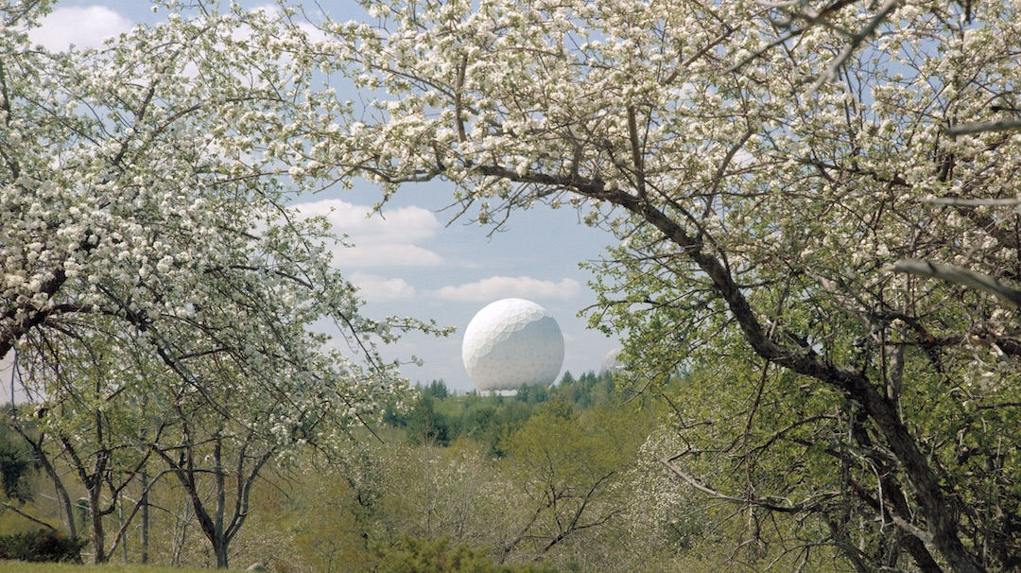

Slide 6
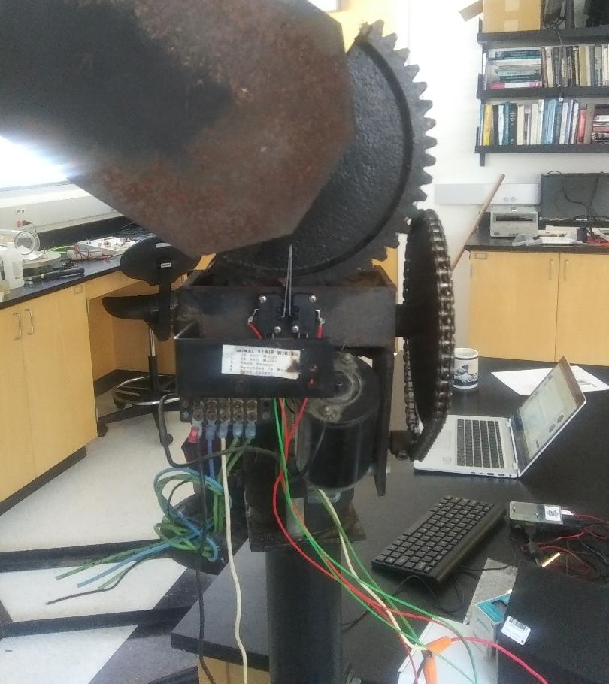
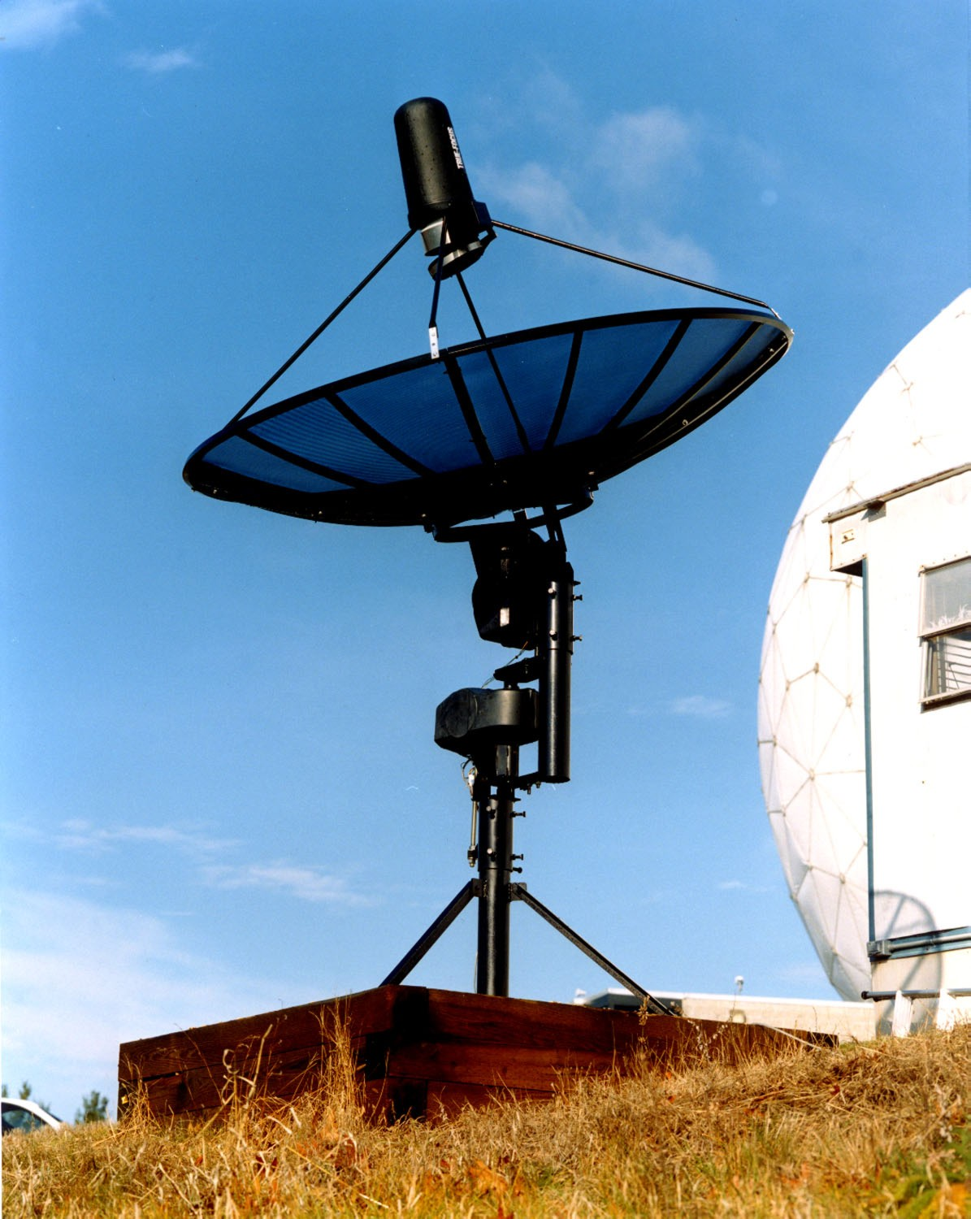
What We Have, What We Don’t
Came with a hexagonal base and mounting system.
Motor/Gear system
Motor
Conversion gears
180° directional gear
Gear Location Sensors
Reed switch sensor
Limiting switches
No Control Box!

Slide 7
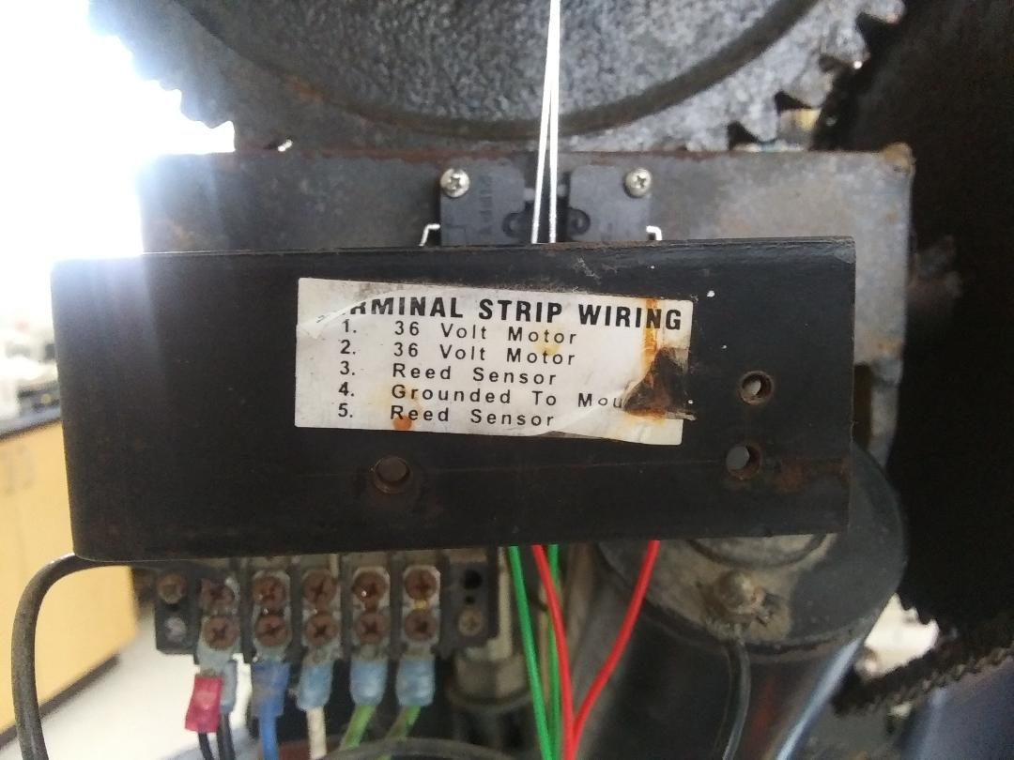

Slide 8
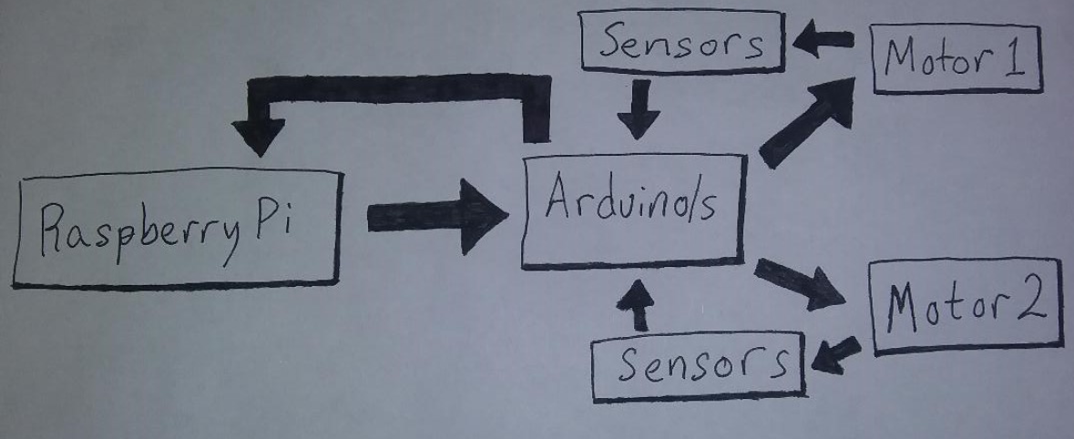

Slide 9
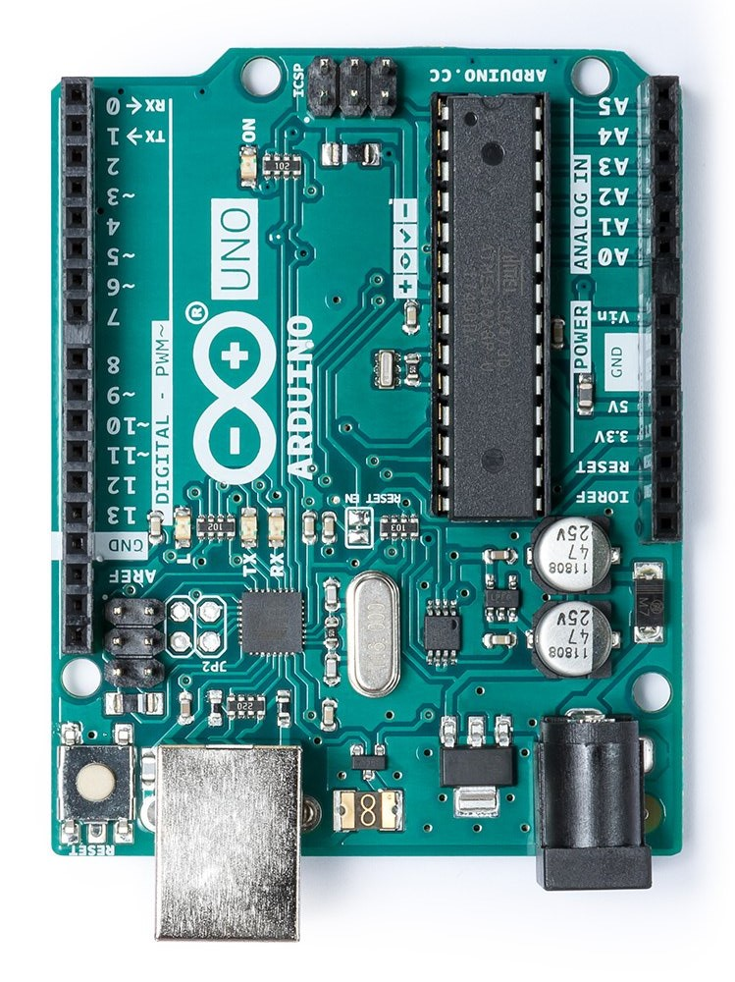
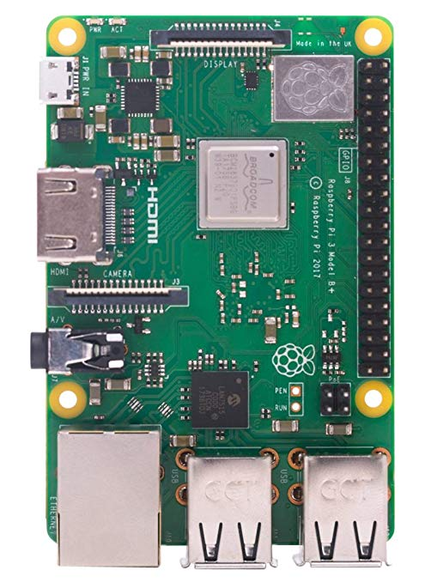

Slide 10
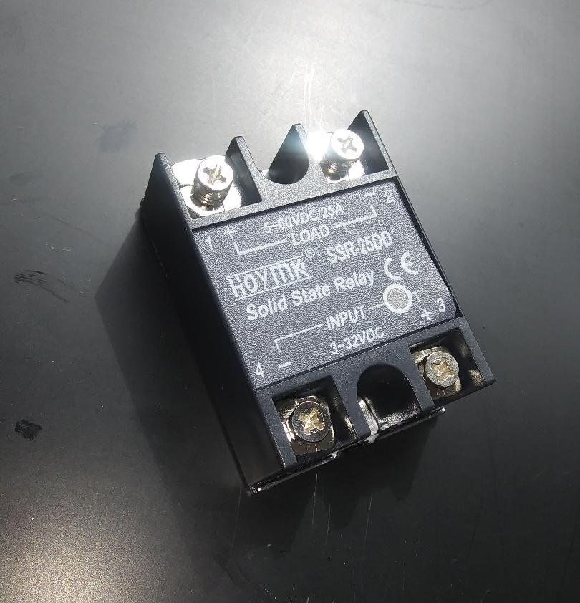
What needs to be done: Motor Controller
A series of switches will be implemented to allow for a reversal of the direction of current through the motor.
The HOYMK SSR-25DD takes an input voltage of 3-32 Volts Direct Current and opens a switch that allows up to 25 Amps through at 5-60 Volts
These switches will be controlled by an Arduino microcontroller.
Each switch the Arduino runs will use a digital pin out on the Arduino and share a common ground.

Slide 11
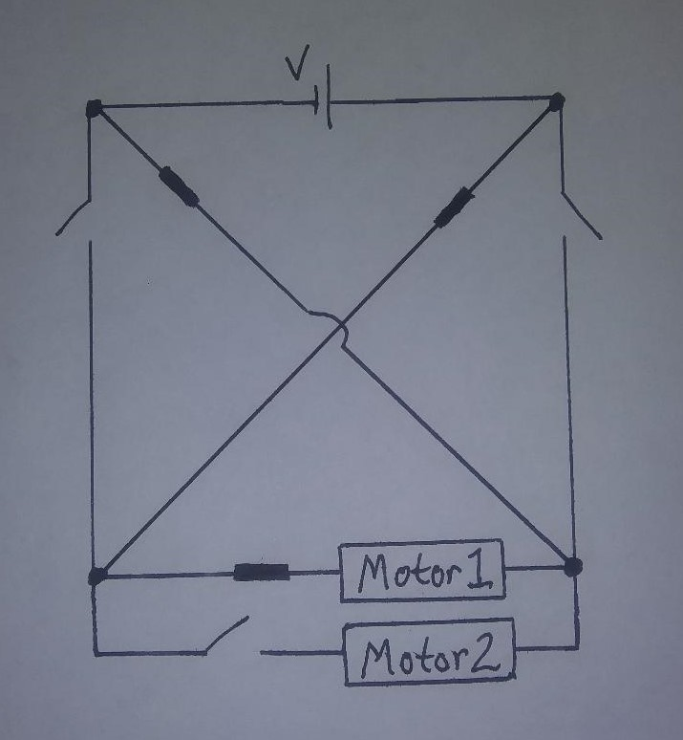
Which way must the current flow?

Slide 12
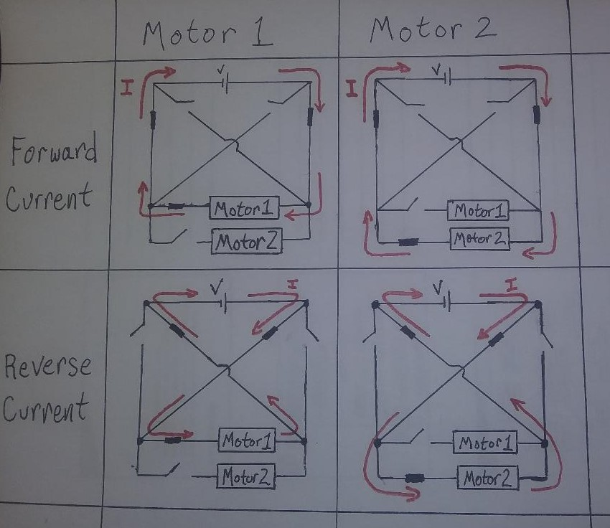

Slide 13
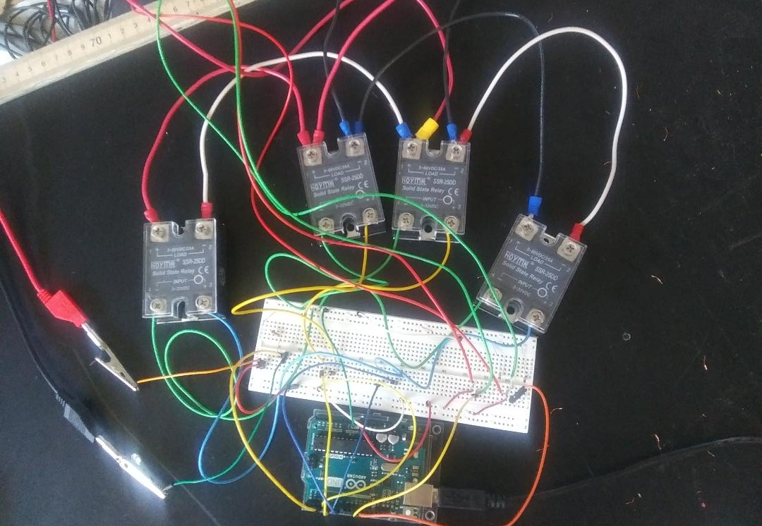


Slide 14
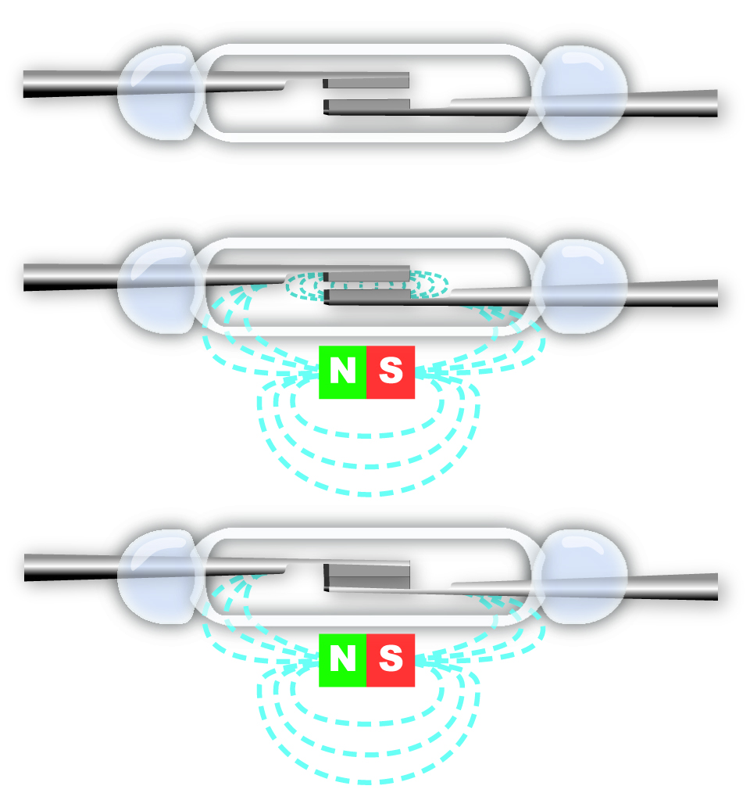
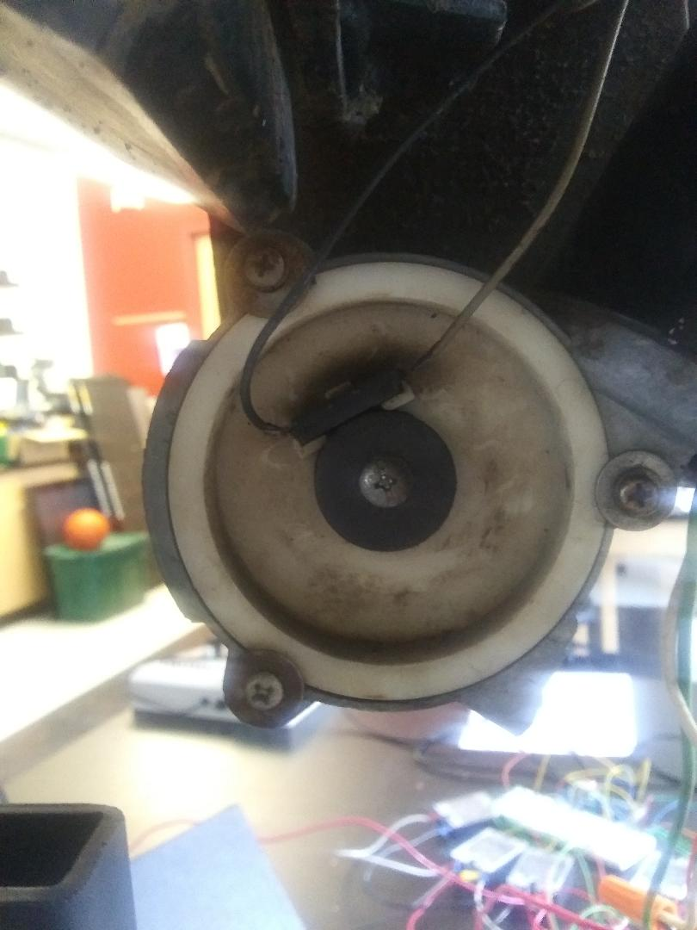
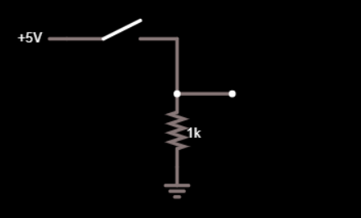
Reed Switch Sensor
Where am I?
A reed switch sensor is a break in a wire that opens and closes as a magnet passes by.
Digital Read:
5 Volts = HIGH (TRUE)
0 Volts = LOW (FALSE)
Digital
Read

Slide 15
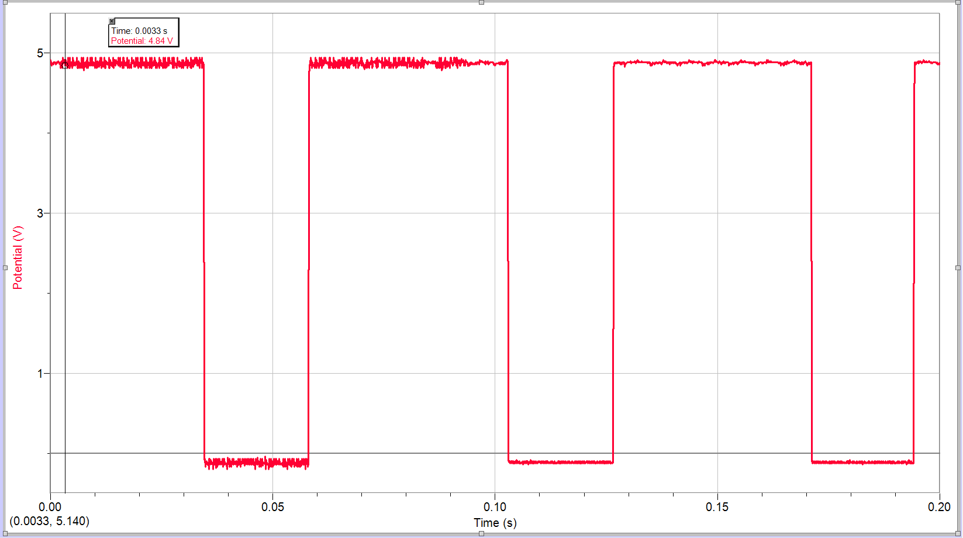
Reed Sensor Reading
Sampled at 10,000 Hz
Signal Period: Approx. 75 ms
50 ms HIGH
25 ms LOW
Very clean signal
May eliminate the need to debounce the sensor
Natural variance in the number of pulses counted between the limits: 0°, 180°
Forward: 2005 ± 15 pulses
Reverse: 2200 ± 150 pulses

Slide 16
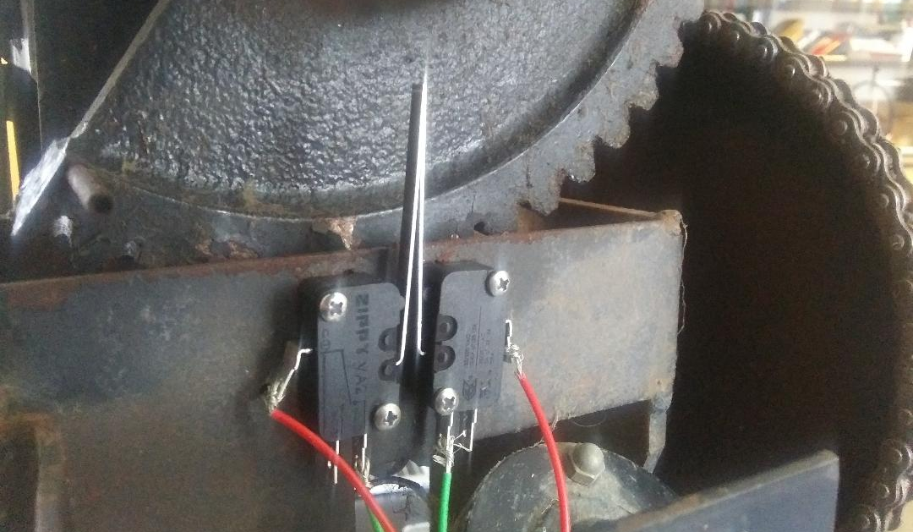
Communication is Important
Limiting switches prevent the motor from going further than it is capable of going based on the gear mechanics.
Were the gear to go further there is the potential for the equipment to be damaged.
There is a consistent count between switches in the forward direction, but not the reverse.
Active low switches

Slide 17
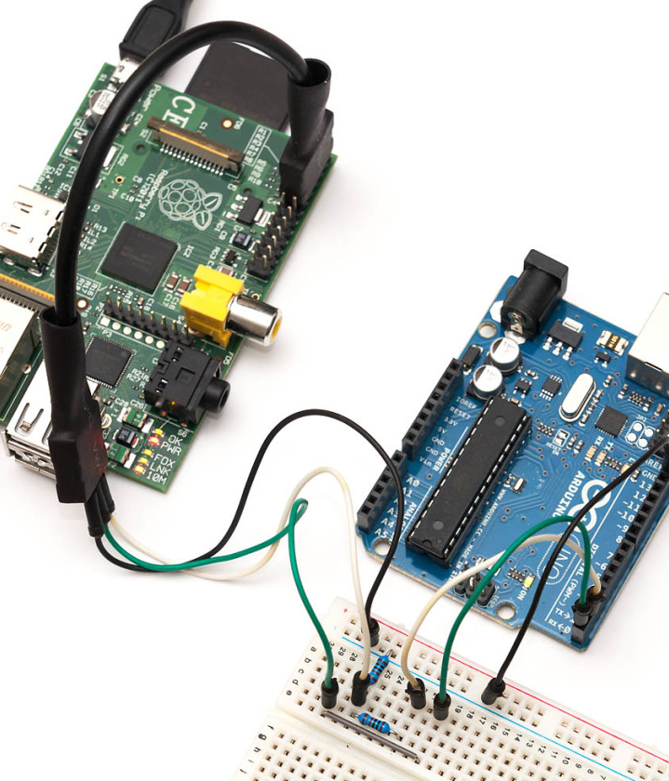
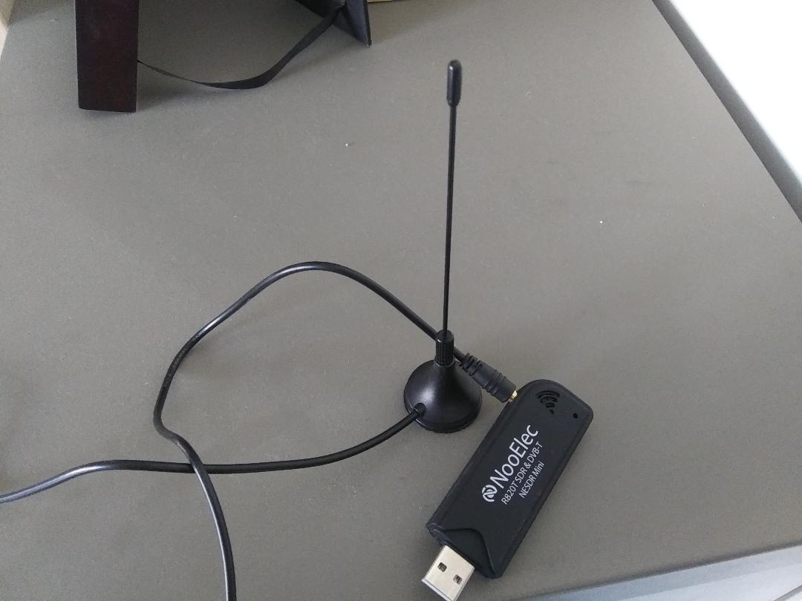
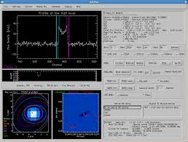
What now?
Calibration:
The motors will need to be calibrated under full load to determine any changes in the pulse/degree ratio
New sensors must be installed
The rats nest of wires needs to be cleaned up and mounted
A communication protocol will be established between the Raspberry Pi and the Arduino
Possible protocols include: I2C, Serial connections, or even sensor to pin out TRUE/FALSE communication
An algorithm must be developed to track objects across the sky
A Software Defined Radio (SDR) and radio receiver will be implemented on the dish
A user interface must be created

Slide 18

Citations
https://www.haystack.mit.edu/edu/undergrad/srt/
https://www.exploreminnesota.com/sports-in-minnesota/6176/rochester-mayo-high-school
https://www.nytimes.com/1998/06/09/nyregion/commemorating-a-discovery-in-radio-astronomy.html
https://www.haystack.mit.edu/index.html
https://en.wikipedia.org/wiki/Karl_Guthe_Jansky
http://www.astro.ucla.edu/~ghezgroup/gc/journey/wavelength.html
https://asd.gsfc.nasa.gov/archive/mwmw/mmw_allsky.html
https://automation-insights.blog/2016/05/04/reed-switches-vs-magnetoresistive-sensors-gmr/
https://playground.arduino.cc/
https://www.raspberrypi.org/
https://oscarliang.com/raspberry-pi-arduino-connected-i2c/
https://www.cv.nrao.edu/~bkent/computing/gridview.html

